Slide 1
Kernel ICA
Nonlinear source separation using kernel methods
Week 13, Group 5

Slide 2
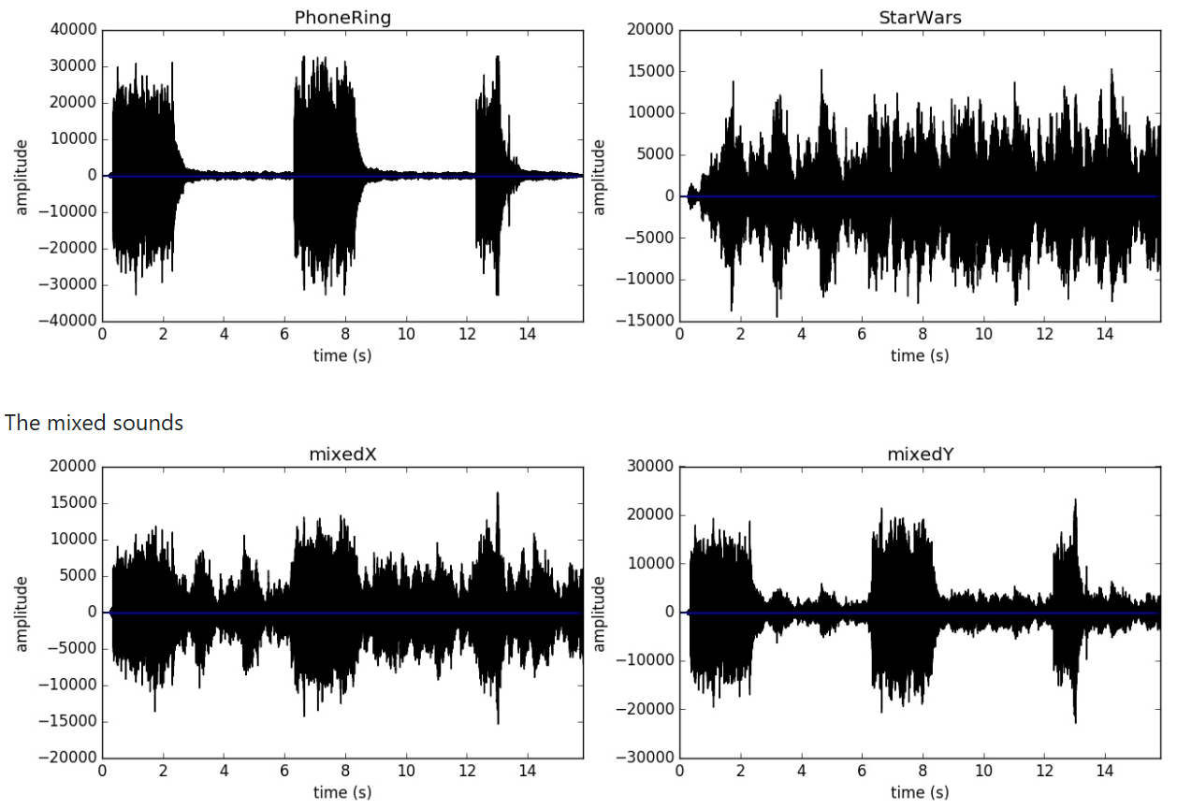

ICA
Independent Component Analysis is a method for separating mixed signals into statistically independent sources
ROOM
FIG: https://github.com/vishwajeet97/Cocktail-Party-Problem/tree/master

Slide 3
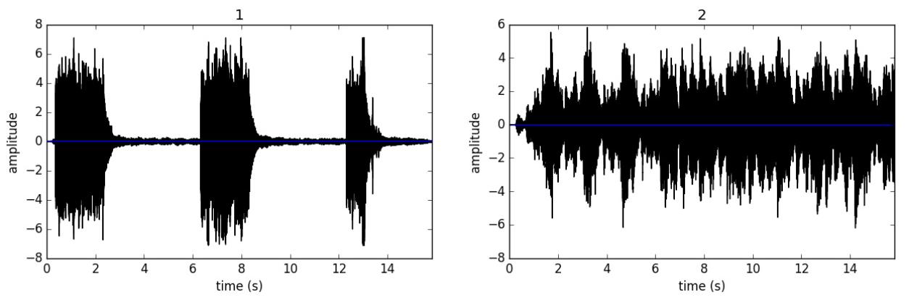
ICA

Slide 4
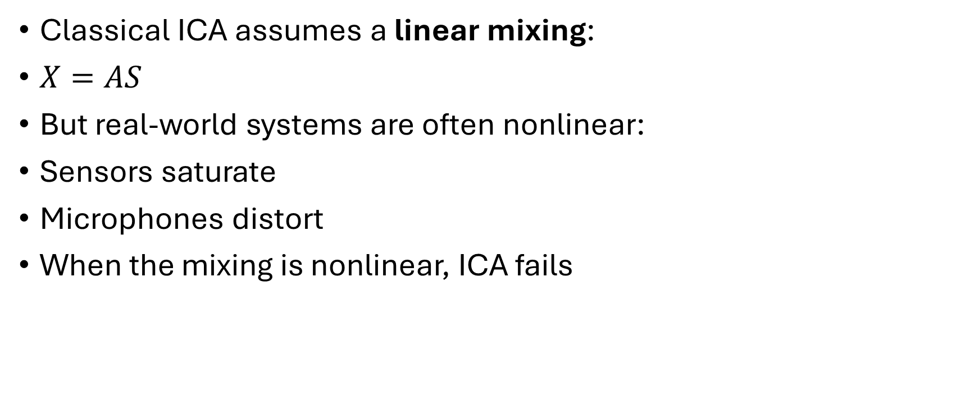
But…
Classical ICA assumes a linear mixing:
$X=AS$
But real-world systems are often nonlinear:
Sensors saturate
Microphones distort
When the mixing is nonlinear, ICA fails

Slide 5
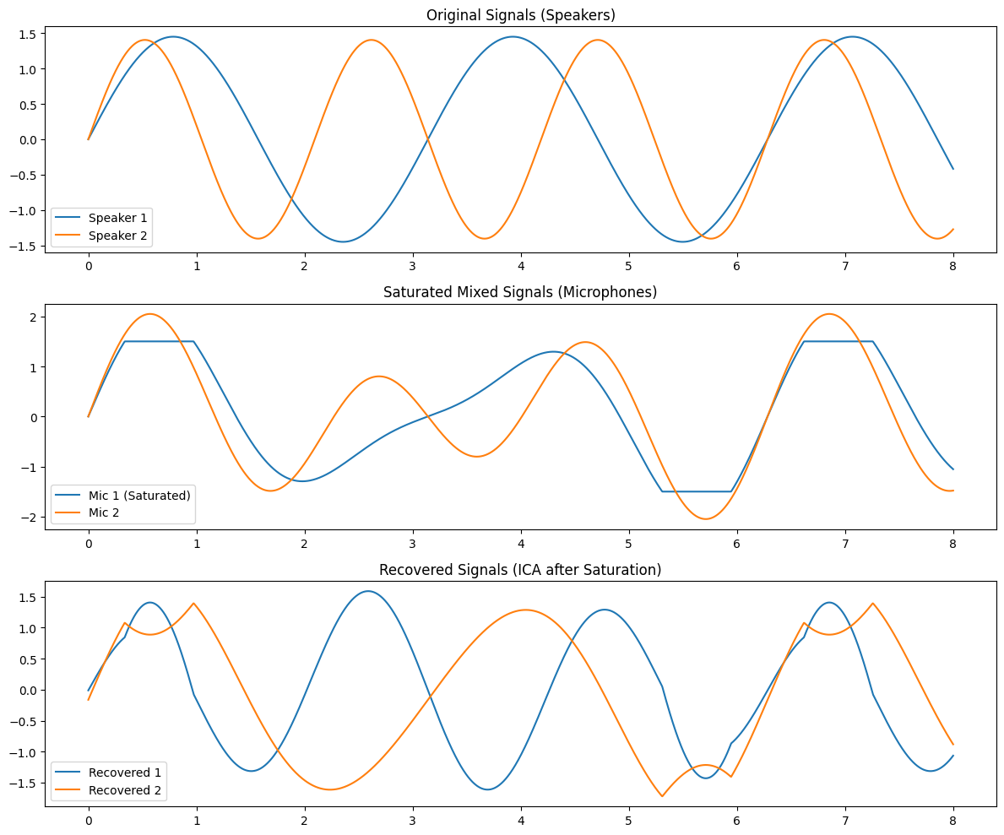
Case: Microphone saturates
ROOM
ICA fails
(only for visualization)
Notes:
Both are deterministic functions of the same variable time.

Slide 6
Over to Kernel ICA
A bit like the kernel trick
Apply a nonlinear kernel to implicitly map the data into a very high-dimensional feature space
Kernel ICA maximizes independence of transformed signals
Independencies measured using kernel-based dependencies such as:
  KCCA (Kernel Canonical Correlation Analysis)
  HSIC (Hilbert-Schmidt Independence Criterion)

Slide 7
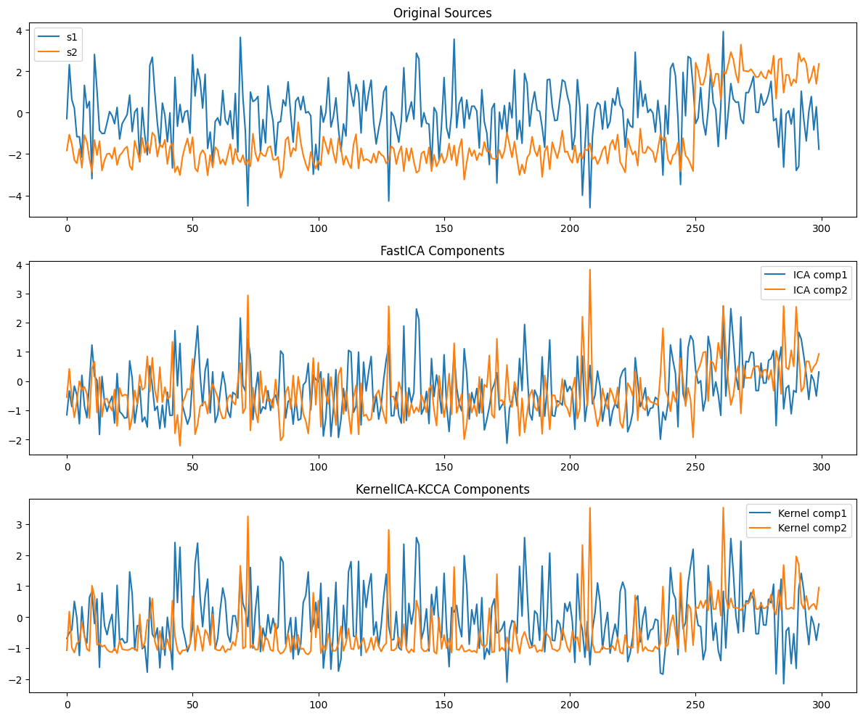
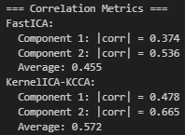
ICA vs Kernel ICA
Following the procedure by Bach et al,. [1]
X1 = np.tanh(s1) + 0.5 * (s2 ** 2)
X2 = np.tanh(s2) + 0.3 * (s1 ** 2)
Y = np.c_[X1, X2]

Slide 8
Sources
1 Bach, F. R., & Jordan, M. I. (2002). Kernel independent component analysis. Journal of Machine Learning Research, 3, 1–48.
2 https://github.com/vishwajeet97/Cocktail-Party-Problem/tree/master

